Slide 1

Event or Conference Cabinet Trip Report
Date

Slide 2


Slide 3
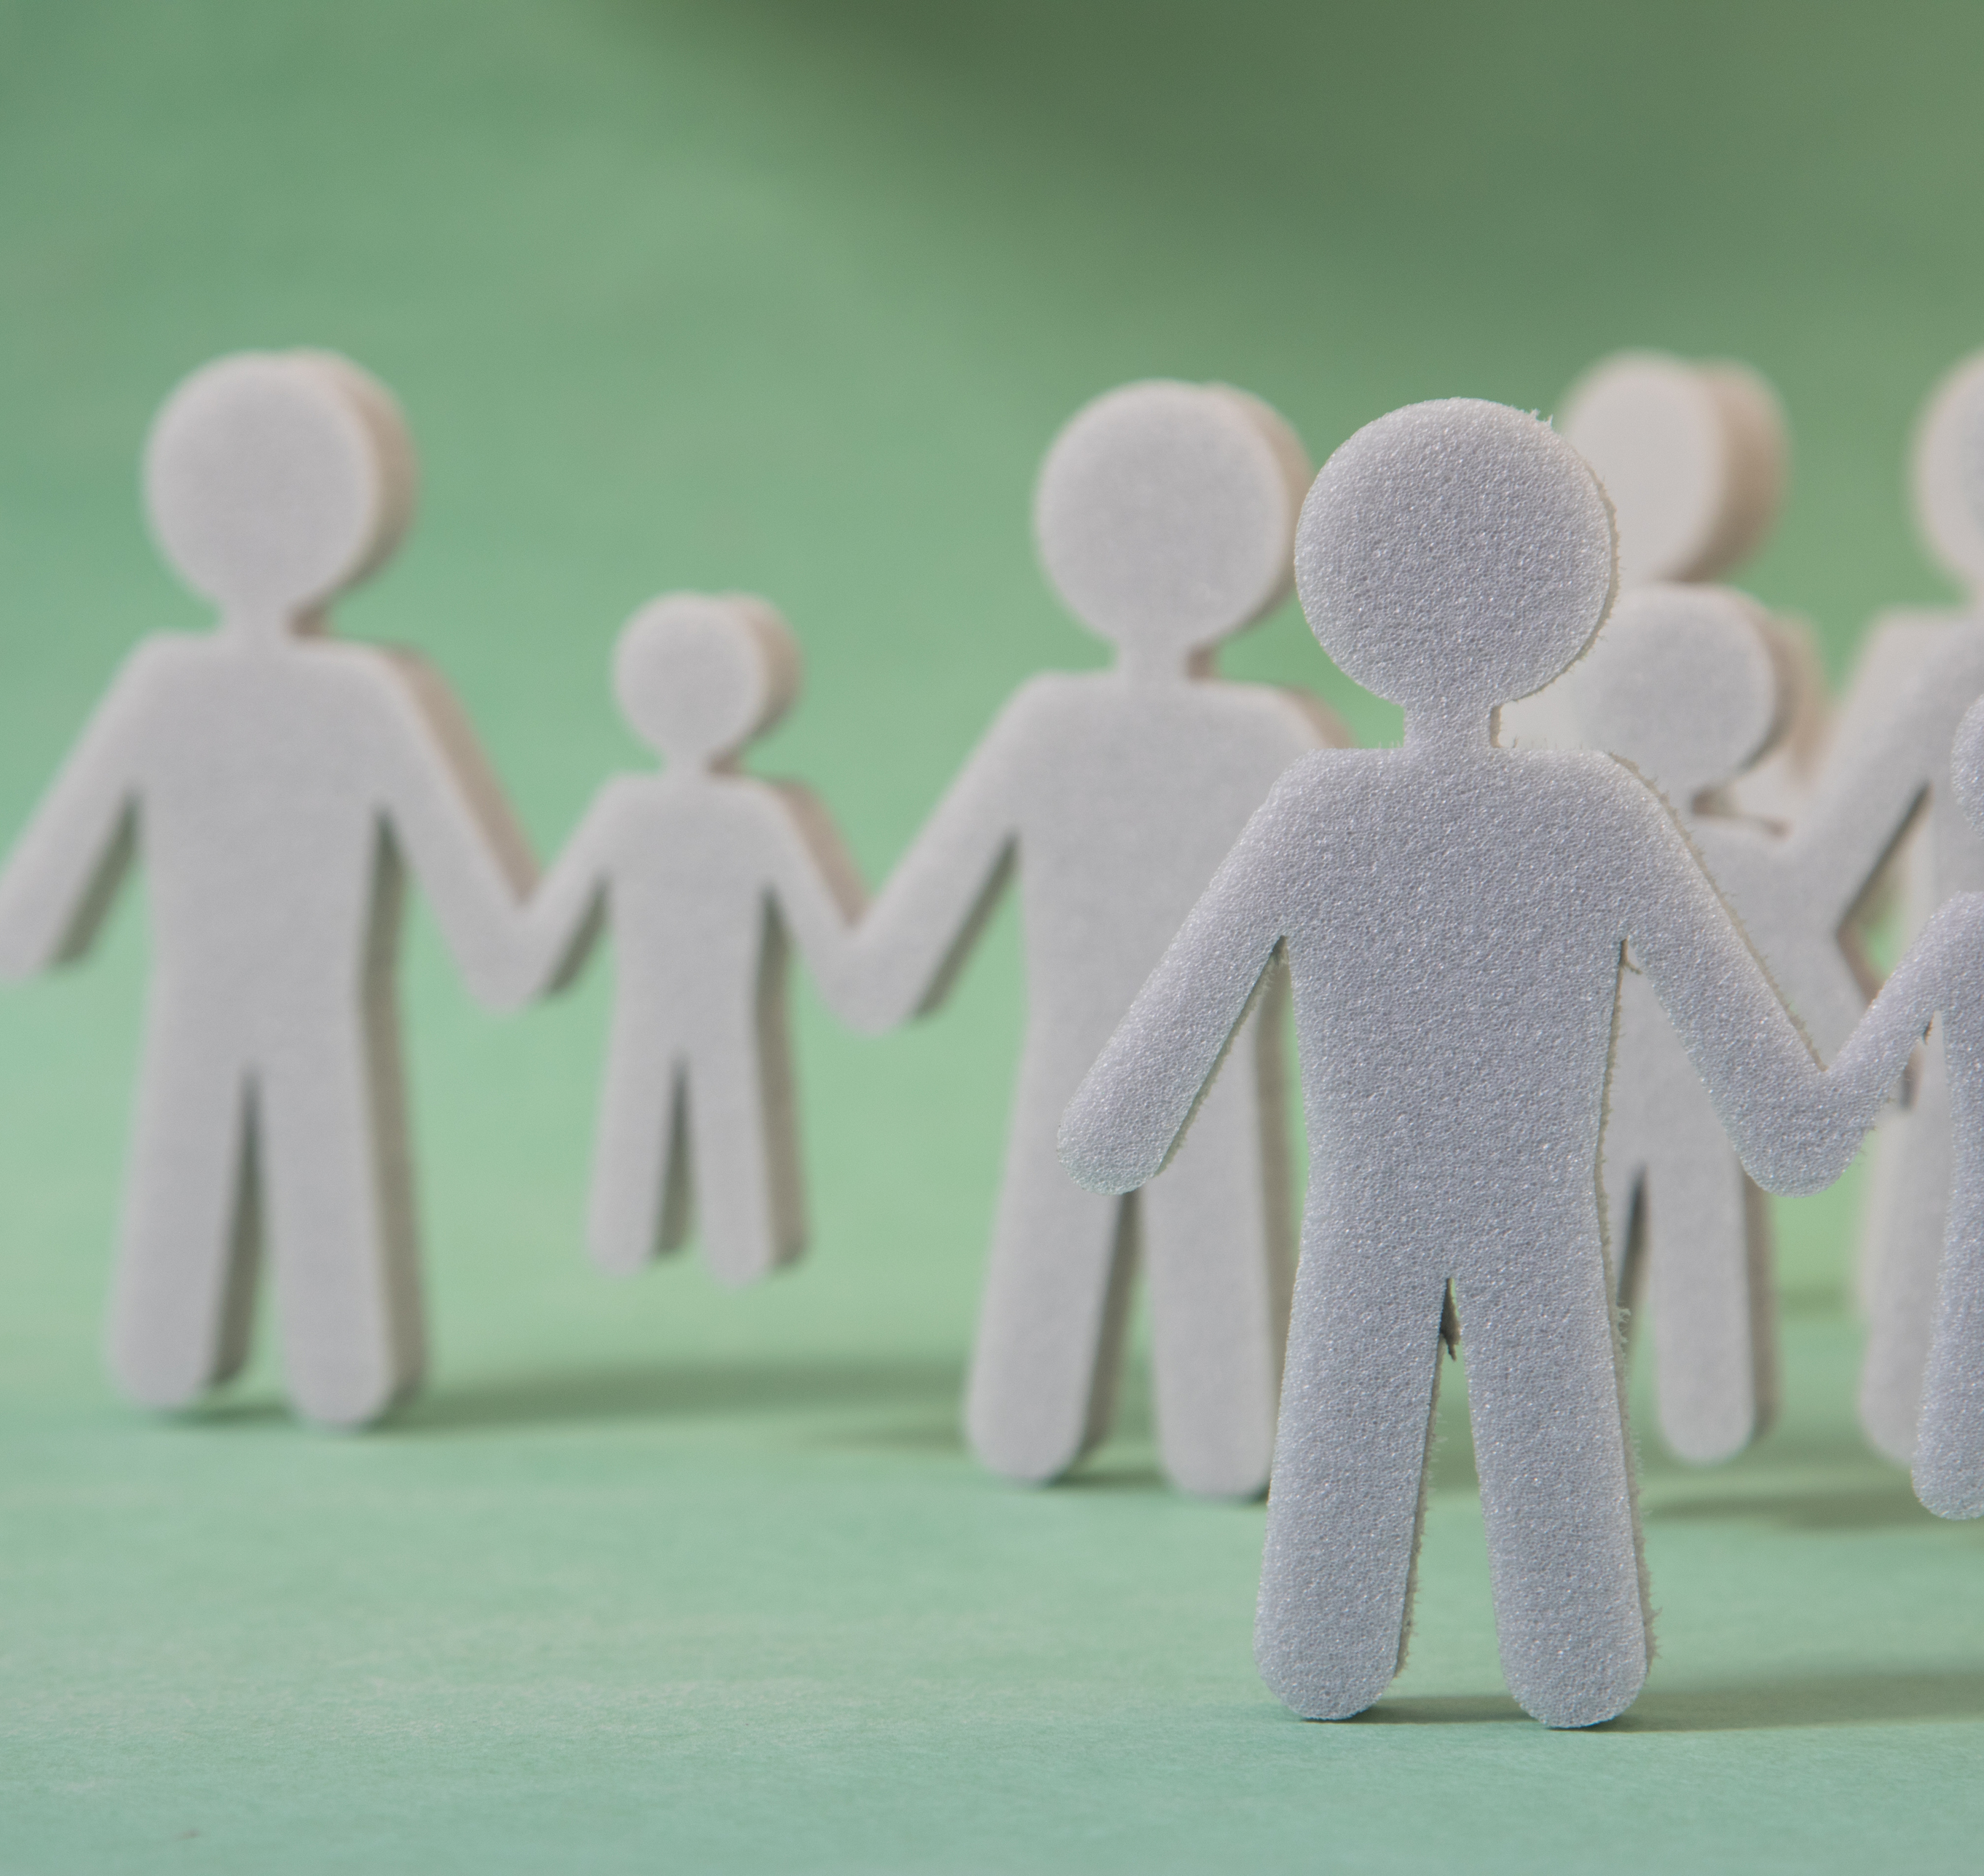
Participants
Name
Name

Slide 4

Event and Location
Event
Location

Slide 5

Date of Trip
DATES

Slide 6

Purpose of Trip
To meet
To learn
To cultivate
To attend
To examine
To ponder

Slide 7
Value of Trip
What I learned that I’ll use in my job
What I learned that is useful to the college
What I can share with others
What I found most interesting

Slide 8

Quyanaqpak! Thank you!
QUESTIONS?

