Slide 1
New Board of Trustees Orientation

Slide 3
Our History
Iḷisaġvik College was founded to primarily serve the residents of the North Slope Borough, America’s largest and most northern municipality.
The intent of its founders was to provide an education based on the Iñupiaq cultural heritage.
1947: NARL (Naval Arctic Research Laboratory) structure built
1954-1980: NARL facilities used for various purposes, including education
1975-1995: North Slope Borough takes ownership, created a training center/college:
Iñupiat University of the Arctic
University of Alaska Extension Center
North Slope Higher Education Center
Arctic Sivunmun Iḷisaġvik College
Mayor’s Workforce Development Center
1996: Incorporated as Iḷisaġvik College through North Slope Borough Charter 8.06
1996: First Graduating Class
1998: Candidacy granted by Northwest Commission on Colleges & Universities (NWCCU)
2003: Full accreditation from Northwest Commission on Colleges & Universities
2006: Became a federally recognized Tribal College
2018: Offered 1st four-year degree program in Business Administration

Slide 4
ORGANIZATIONAL CHART
Departments & Divisions
Board of Trustees
President
Dean of Administration
Chief Financial Officer
Dean of Academic Affairs
External Affairs
Dean of Students
Exec. Director of Human Resources
Exec. Dir. of Institutional Advancement
Bookstore
Business Office
Instructional Programs
Community Outreach
Recruiting
Employee Relations
Development
Compliance and Safety
Grants Office
Academic
Voc-Ed
CWFD
Student Life
Maintenance & Operations
Financial Aid
Admissions & Registration
Student Wellness
Marketing
Institutional Research
Adult Education
Travel
Food Services
Information Technology
Library
Key
Executive
Supervisors
Staff/Faculty
Affiliate Faculty

Slide 5
Vision & Mission
TIKISAKSRAQ / VISION
Ikayuutauluta Nunaaqqiñun Suaŋŋaktaaġlugit Iḷisaġnikunlu Suraġallasiñikunlu.
To Help Build Strong Communities through Education and Training.
SIVUNIQ / MISSION
IỊisaġvik College iỊisalluataġviqaqtitchiruq iḷisavsaallasiniġmun, savaaqallasiñiġmun suli sum savagnaġniŋagun iỊisaġviqaqhutiŋ sivunmun suli suaŋŋaktaallavlugu Iñupiat iñuuniaġusiat, Iñupiuraaġniŋat, piqpagiraŋisigun, suli piraġausiŋisigun.
Iḷisaġvik College provides quality post-secondary academic, career and technical education in a learning environment that perpetuates and strengthens Iñupiat culture, language, values and traditions.
Naparuq ikayuutauvłuni iḷisaqtuanun suli naupkaqługi iḷitchiḷḷuataŋaruat suli anniqsuutaullasiŋaruat savaktiksrat North Slope-miḷu State of Alaska-miḷu.
It is dedicated to serving its students and developing a well-educated and trained workforce who meet the human resource needs of North Slope employers and the state of Alaska.

Slide 7
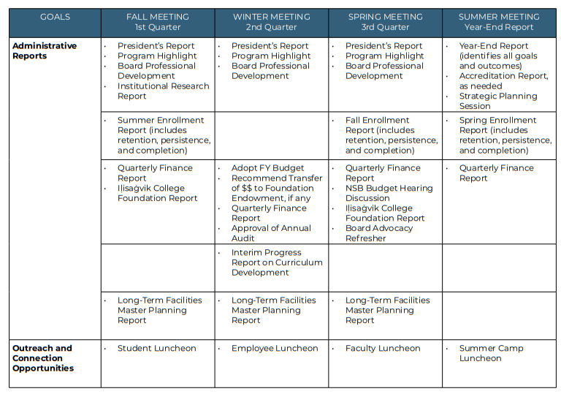
Meetings & General Scheduling
Quarterly Meetings:
Fall: September
Winter : November/December
Spring: March
Summer : June
Other Meetings:
NSBSD/IC Joint Meeting
Nunaaqqiurat Tumitchiaŋit
Compensation:
Special Meetings $400
Regular Meeting $400 & Workshops $250
Iḷisaġvik College covers travel and lodging costs for each member of the Board to attend meetings in person.

Slide 8
Iḷisaġvik's Degrees & Programs
Most popular
Business Management
Allied Health
Iñupiaq Studies

Slide 9
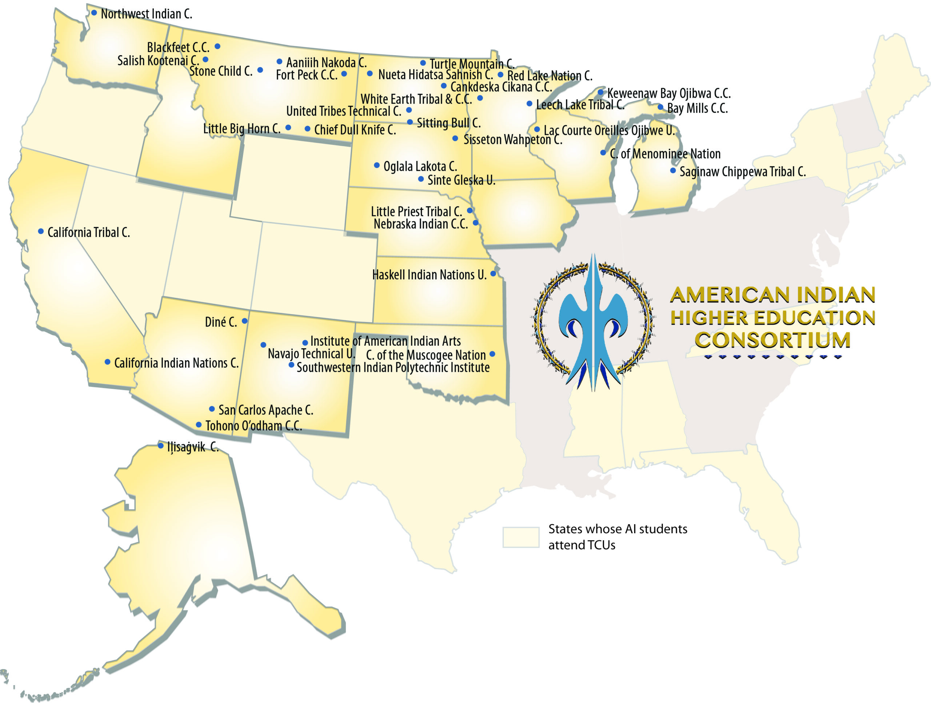
Accredited by the Northwest Commission on Colleges and Universities.
AIHEC | American Indian Higher Education Consortium
Consortium of Tribal Colleges & Universities
Tribally chartered by ICAS
51% AK/NA enrollments
Board majority AK/NA

Slide 10
Board of Trustees
Comprised of 12 Board of Trustees
1 (8) from each North Slope Community
1 At-large
1 Trustee Iñupiat Community of the Arctic Slope
1 Trustee North Slope Borough School District
1 Trustee Arctic Slope Regional Corporation

Slide 11
Terms of Office
Each Trustee shall serve a term of five (5) years commencing on January 1 following his or her appointment.
Trustees shall be appointed by the North Slope Borough Assembly as required by the Articles of Incorporation.
Any vacancy occurring in the Board of Trustees shall be filled by appointment made by the (Members) North Slope Borough Assembly (Assembly), for the unexpired portion of the term, from nominations submitted to Assembly by the North Slope Borough Mayor, provided that, the Assembly need not fill a vacancy where the remaining unexpired term is less than 60 days.
Any Trustee appointed to fill a vacancy shall serve through the unexpired term of the vacant seat.

Slide 12
Officers Section 1
The Officers of Iḷisaġvik College include: President, Chairperson, Vice-Chairperson, Secretary, and Treasurer. With the exception of the President, all Officers are members of the Board of Trustees.
With the exception of the President, which is governed by the terms and conditions of an employment contract, all Officers are appointed by the Board of Trustees and hold office at the pleasure of the Board of Trustees.
Officers are appointed by majority vote of the Board held at the first regular meeting in each calendar year, or at the first regular meeting following a vacancy in office.
Each Officer is appointed for a one (1) year term and may serve in the same office for up to five (5) consecutive terms, after which such Director may not serve in that office for at least one (1) year before that Director may be appointed to that office.

Slide 13
Expectations of Attendance section 4 (i)
Our Bylaws require a majority of the Trustees be present in order to establish quorum and conduct business, so it is critical to make Iḷisaġvik College Board of Trustees meetings a priority.
Each Director is required to attend all workshops, regular and special meetings of the Board of Directors. Directors are required to attend in person for all regular meetings, with virtual attendance a last resort (i.e. due to weather and travel limitations).
If a Director is unable to attend any such meeting, the Director shall provide advance notice to the Chairperson or Secretary (who shall then notify the Chairperson) in advance of the meeting.

Slide 14
Manner of Governing 1.05
The Board will govern lawfully, in a manner that emphasizes:
(a) Iñupiaq values;
(b) Outward vision rather than an internal preoccupation;
(c) Encouragement of diversity in viewpoints;
(d) Strategic leadership more than administrative detail;
(e) Clear distinction of board and presidential roles;
(f) Collective rather than individual decisions;
(g) Preparing for the future while honoring knowledge and traditions; and
(h) Proactivity rather than reactivity.

Slide 15
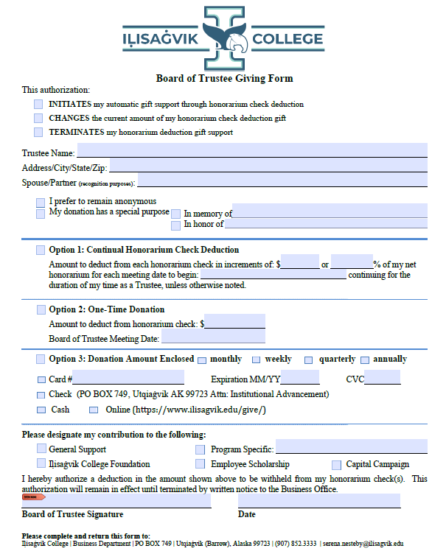
Board Advocacy & Giving
100% Board Giving – some grants inquire
$12,000/Board Goal & $1000/Trustee
Options
Honorarium Deduction
One Time Donation
Pick.Click.Give
Weekly/monthly/quarterly/annually

Slide 16
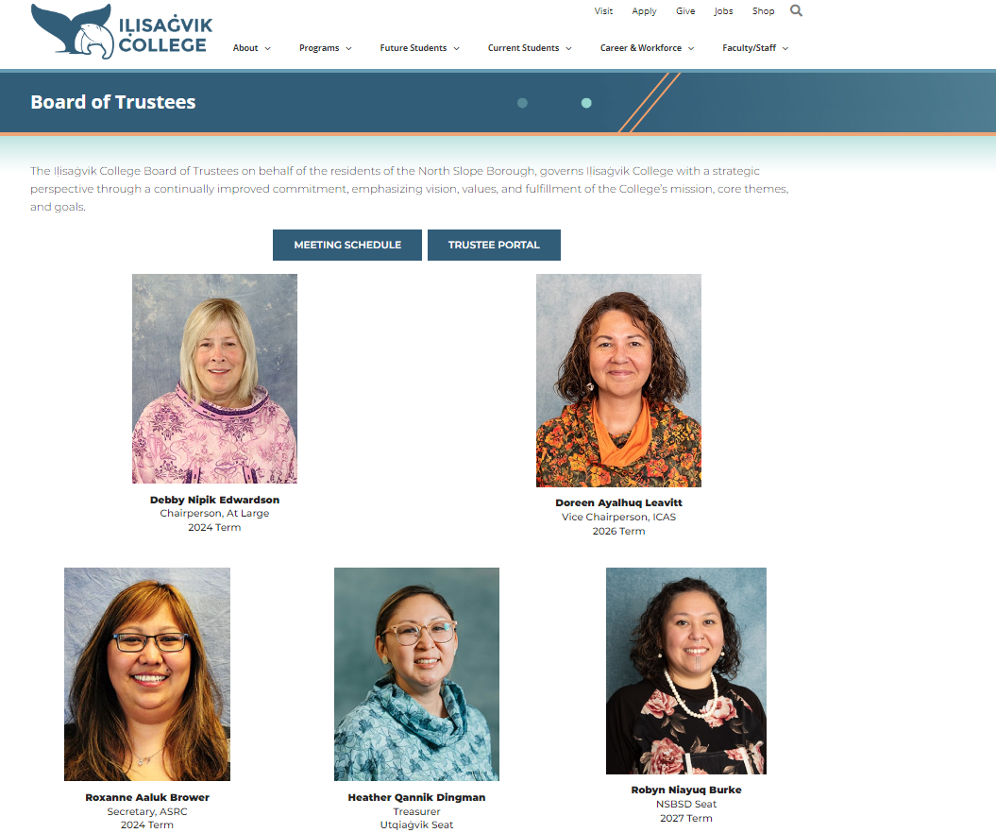
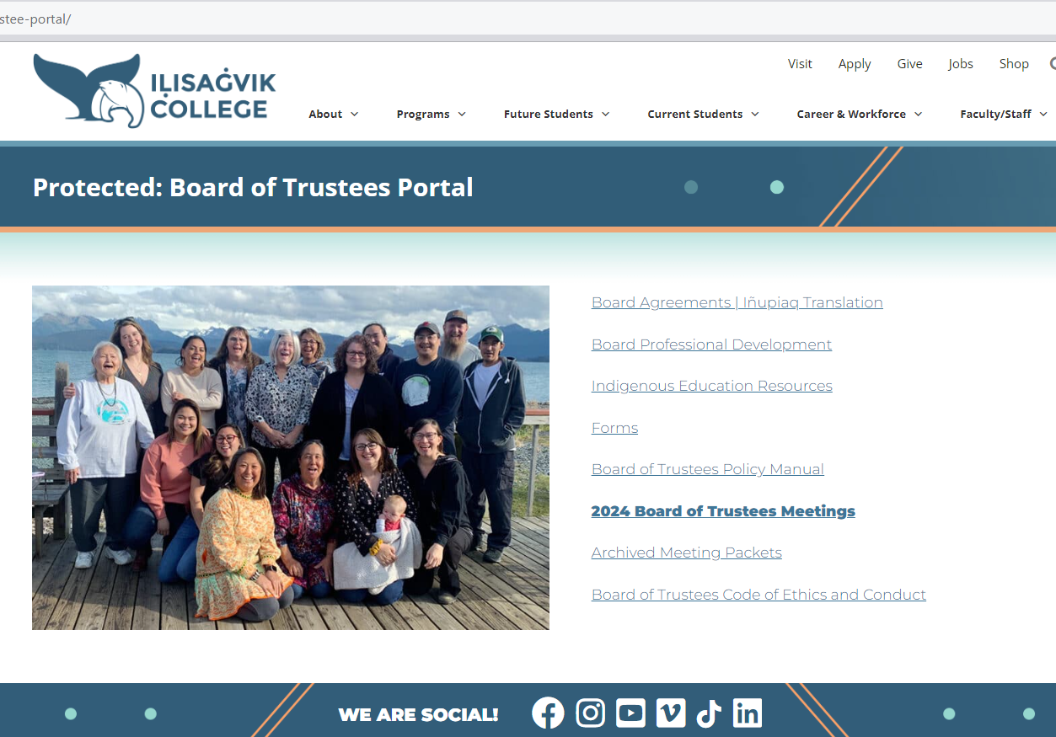
Online Board Portal

Slide 17
Online Resources
Board Policies
Meeting Schedule
Strategic Plan & Outcomes
Institutional Research Report
Board Agreements
Past meeting packets
Iḷisaġvik Foundation Information
Paper copies upon request

Slide 18
Office of the President
Justina Wilhelm, MSW
President
Phone: (907) 852-1820
Email: justina.wilhelm@ilisagvik.edu
Clarissa Pelia
Executive Assistant to the President | Board Secretary
Phone: (907) 852-1820
Email: clarissa.pelia@ilisagvik.edu
The Office of the President staff handle the administrative and day-to-day operations of the institution. Any questions or requests for information should be directed to our staff.
The Executive Assistant to the President/Board Secretary will be your primary point of contact.
The Office of the President welcomes any questions, requests, or feedback from our Board of Trustees at any time.
Office of the President Communications

Slide 19
Quyanaqpak! Thank you!

